Slide 1


HEP Weekly Report NTUA 15/7/2020
George Bakas

Slide 2
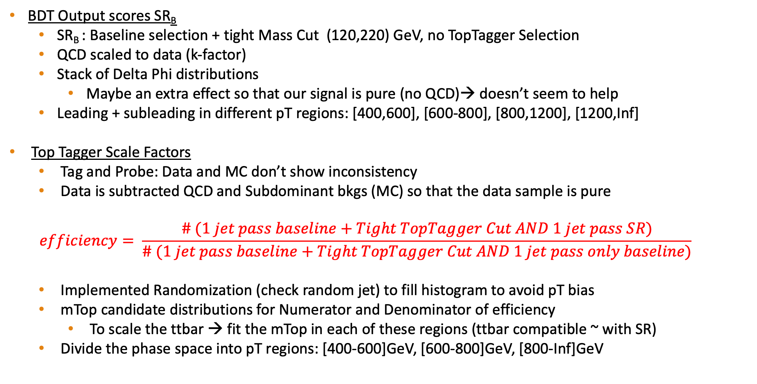
Status Report
BDT Output scores SR_{B}
SR_{B} : Baseline selection + tight Mass Cut (120,220) GeV, no TopTagger Selection
QCD scaled to data (k-factor)
Stack of Delta Phi distributions
Maybe an extra effect so that our signal is pure (no QCD)→ doesn’t seem to help
Leading + subleading in different pT regions: [400,600], [600-800], [800,1200], [1200,Inf]
Top Tagger Scale Factors
Tag and Probe: Data and MC don’t show inconsistency
Data is subtracted QCD and Subdominant bkgs (MC) so that the data sample is pure
$$efficiency= \frac{\# (1 jet pass baseline+Tight TopTagger Cut AND 1 jet pass SR)}{\# (1 jet pass baseline+Tight TopTagger Cut AND 1 jet pass only baseline)}$$
Implemented Randomization (check random jet) to fill histogram to avoid pT bias
mTop candidate distributions for Numerator and Denominator of efficiency
To scale the ttbar → fit the mTop in each of these regions (ttbar compatible ~ with SR)
Divide the phase space into pT regions: [400-600]GeV, [600-800]GeV, [800-Inf]GeV

Slide 3
Signal Selection
Control Region Selection
Variables | Selected Cut
pT (both leading jets) | > 400 GeV
Njets | > 1
N leptons | = 0
|eta| (both leading jets) | < 2.4
mJJ | > 1000 GeV
jetMassSoftDrop (only for fit) | (50,300) GeV
Top Tagger | > 0.2
B tagging (2 btagged jets) | > Medium WP
Signal Trigger
Variables | Selected Cut
pT (both leading jets) | > 400 GeV
Njets | > 1
N leptons | = 0
|eta| (both leading jets) | < 2.4
mJJ | > 1000 GeV
jetMassSoftDrop (only for fit) | (50,300) GeV
Top Tagger | > 0.2
B tagging (0 btagged jets) | < Medium WP
Control Trigger

Slide 4
Stack of variables in SRB
2016
2017
2018

Slide 5
Stack of variables in SRB (2016)

Slide 6
Stack of variables in SRB (2017)

Slide 7
Stack of variables in SRB (2018)

Slide 8
TagAndProbe Efficiency (2016)
Efficiency (George)
eff data: 0.782 ± 0.039
eff ttbar: 0.772 ± 0.014
Efficiency (Giannis)
eff data: 0.788 ± 0.04
eff ttbar: 0.769 ± 0.014
Tight TopTagger + SR TopTagger
Tight TopTagger + Probe

Slide 9
TagAndProbe Efficiency (2017)
Efficiency (George)
eff data: 0.864 ± 0.043
eff ttbar: 0.875 ± 0.007
Efficiency (Giannis)
eff data: 0.873 ± 0.056
eff ttbar 0.862 ± 0.007
Tight TopTagger + SR TopTagger
Tight TopTagger + Probe

Slide 10
TagAndProbe Efficiency (2018)
Efficiency (George):
eff data: 0.822 ± 0.034
eff ttbar: 0.839 ± 0.005
Efficiency (Giannis):
eff data: 0.792 ± 0.034
eff ttbar: 0.827 ± 0.005
Tight TopTagger + SR TopTagger
Tight TopTagger + Probe

Slide 11
TagAndProbe Efficiency per Pt region (2016)
Efficiency per Pt region
eff data pT[400-600]: 0.762 ± 0.043
eff ttbar pT[400-600]: 0.778 ± 0.016
-----------
eff data pT[600-800]: 0.854 ± 0.103
eff ttbar pT[600-800]: 0.748 ± 0.031
-----------
eff data pT[800-Inf]: 0.888 ± 0.161
eff ttbar pT[800-Inf]: 0.775 ± 0.064
pT [400,600]GeV
pT [600,800]GeV
pT [800,Inf]GeV

Slide 12
TagAndProbe Efficiency per Pt region(2017)
Efficiency per Pt region
eff data pT[400-600]: 0.880 ± 0.049
eff ttbar pT[400-600]: 0.874 ± 0.008
-----------
eff data pT[600-800]: 0.799 ± 0.091
eff ttbar pT[600-800]: 0.876 ± 0.018
-----------
eff data pT[800-Inf]: 0.796 ± 0.2
eff ttbar pT[800-Inf]: 0.898 ± 0.045
pT [400,600]GeV
pT [600,800]GeV
pT [800,Inf]GeV

Slide 13
TagAndProbe Efficiency per Pt region(2018)
Efficiency per Pt region
eff data pT[400-600]: 0.824 ± 0.039
eff ttbar pT[400-600]: 0.837 ± 0.006
-----------
eff data pT[600-800]: 0.819 ± 0.066
eff ttbar pT[600-800]: 0.847 ± 0.013
-----------
eff data pT[800-Inf]: 0.789 ± 0.141
eff ttbar pT[800-Inf]: 0.868 ± 0.032
pT [400,600]GeV
pT [600,800]GeV
pT [800,Inf]GeV

